Slide 1
The PIC microcontroller
PIC18F4520: ADC

Slide 2
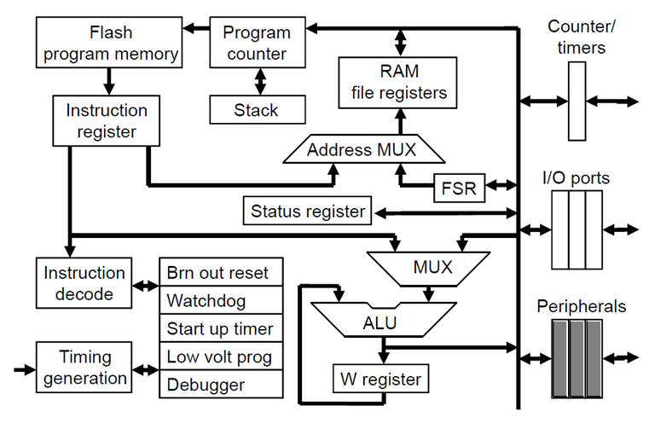
PIC18F: Controller Architecture

Slide 3
PIC18F: Notational convention
WREG
W Register
FREG
File Register (any register location from GPR Bank 0 / SFR)
[X]
Contents of register X
[WREG] = 0x02 ↔ WREG’s contents become 0x02
[0x20] = 0x34 ↔ RAM File Register 0x20 content becomes 0x34
[X] = [Y] ↔ Contents of Y are copied into X
Number systems
Decimal | d’10’
Hexadecimal | h’4A’ or 0x4A
Binary | b’1000 0010’

Slide 4
ADC from Analog to digital

Slide 5
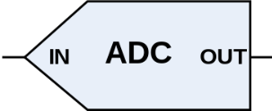
Electronics: Concept of ADC
The real-world is analog; the computer world is digital
The two interact only if analog is converted to digital
Or vice versa!
ADC
Analog to Digital Converter
Analog voltage
n-bit Digital output
Reference voltage
n: resolution of the ADC
V_{REF} : reference voltage

Slide 6
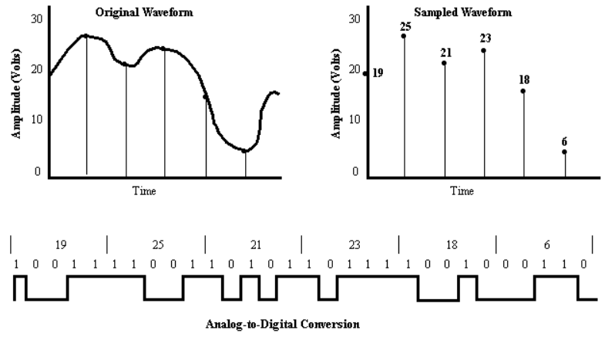
Electronics: The ADC process
Consider a 5-bit ADC
ADC is a lossy process
Sampling errors, quantization errors

Slide 7
Electronics: ADC Glossary
Terms:
Resolution
Number of bits an ADC gives as output
Higher this number, finer the resolution of the ADC
V_{REF}
Reference Voltage - maximum analog voltage that ADC will convert
Voltages above this will be ‘saturated’
Conversion time
Time taken for a single conversion
Depends on ADC clock, internal conversion circuitry, etc.
Data exchange:
Analog input channel
Pin / terminal for applying analog voltage to be converted
Digital data output
n-bit digital number output from the ADC in 1/more registers
Signals:
Start conversion (GO)
Signal to ADC to start the conversion
End-of-conversion (DONE)
Signal from ADC that conversion is completed

Slide 8
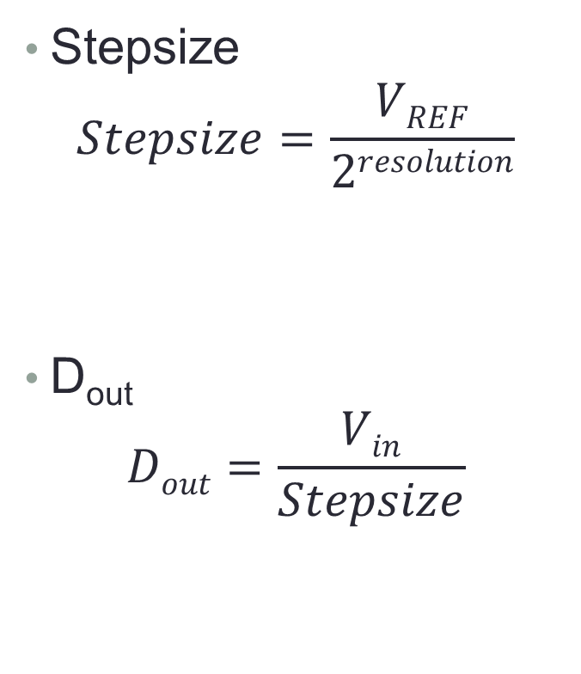
ADC: System equations
Stepsize
$$Stepsize=\frac{VREF}{2resolution}$$
D_{out}
$$Dout=\frac{Vin}{Stepsize}$$
V_{REF} | Resolution | Stepsize
5V | 8-bits | 19.53mV
5V | 10-bits | 4.88mV
2V | 10-bits | 1.95mV
V_{in} | Stepsize | D_{out}
2V | 19.53mV | 102
4.5V | 4.88mV | 922
1V | 1.95mV | 512

Slide 9
ADC: A graphical view
A plot of an ADC configuration – input and output side
V_{in}
D_{out}
Saturation
V_{REF+}
2^{resolution}-1
Dynamic
Range
2*Stepsize
…
2
Stepsize
1
0
0

Slide 10
Electronics: An ADC calculator!
Handy ADC calculator – embedded Excel sheet

Slide 11
PIC18F4520: In-built ADC
ADC circuitry
13 analog input channels
AN0 – AN12
One 10-bit ADC
Analog channels need to be connected turn-by-turn
13-way input multiplexing
To be implemented in code (for loop)
Usage through:
3 ‘config’ registers – ADCON0, ADCON1, ADCON2
2 ‘result’ registers – ADRESH, ADRESL

Slide 12
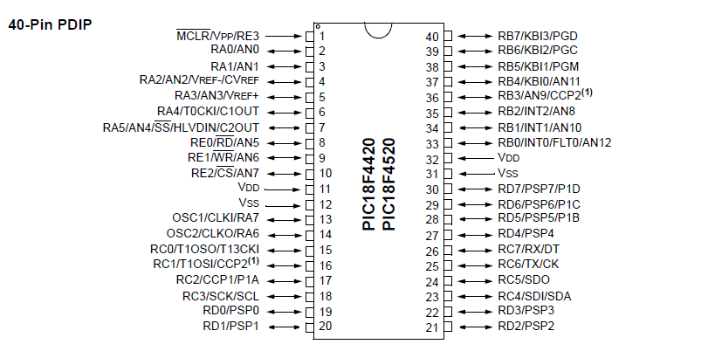
PIC18F4520: ADC pins – ANx, V_{REF}

Slide 13
PIC18F4520: ADCON0
CHS<3:0>: Analog input channel select bits
0000: AN0
0001: AN1
…
1100: AN12
1101 to 1111: Not implemented
GO/DONE: ADC conversion status bit
1: ADC conversion in progress
0: ADC done/idle
ADON: ADC module ON bit
1: On, 0: Off
-
-
CHS3
CHS2
CHS1
CHS0
GO/
DONE
ADON

Slide 14
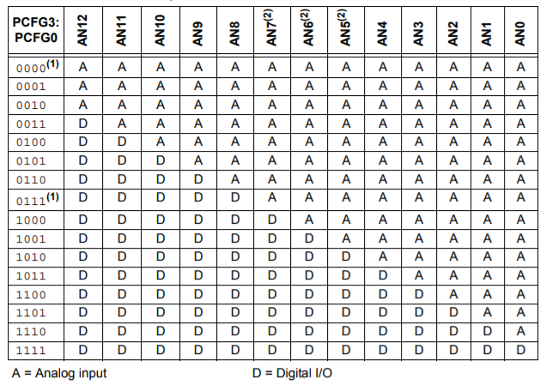
PIC18F4520: ADCON1
-
-
VCFG1
VCFG0
PCFG3
PCFG2
PCFG1
PCFG0
VCFG1: Voltage reference config bit (V_{REF-} source)
1: V_{REF-} (AN2), 0: V_{SS}
VCFG0: Voltage reference config bit (V_{REF+} source)
1: V_{REF+} (AN3), 0: V_{DD}
PCFG<3:0>: Port configuration control bits
D
E
F
R

Slide 15
PIC18F4520: ADCON2
ADFM
-
ACQT2
ACQT1
ACQT0
ADCS2
ADCS1
ADCS0
ADFM: Output justification bit (10 out of 16-bit ADRESH:ADRESL)
0: left, 1: right
ACQT<2:0>: Automated acquisition time bits
000: 0T_{AD}
001: 2T_{AD}
010: 4T_{AD}
…
111: 20T_{AD}
ADCS<2:0>: ADC conversion clock selection bits
000: F_{OSC}/2
001: F_{OSC}/8
010: F_{OSC}/32
100: F_{OSC}/4
101: F_{OSC}/16
110: F_{OSC}/64
010, 111: F_{RC}

Slide 16
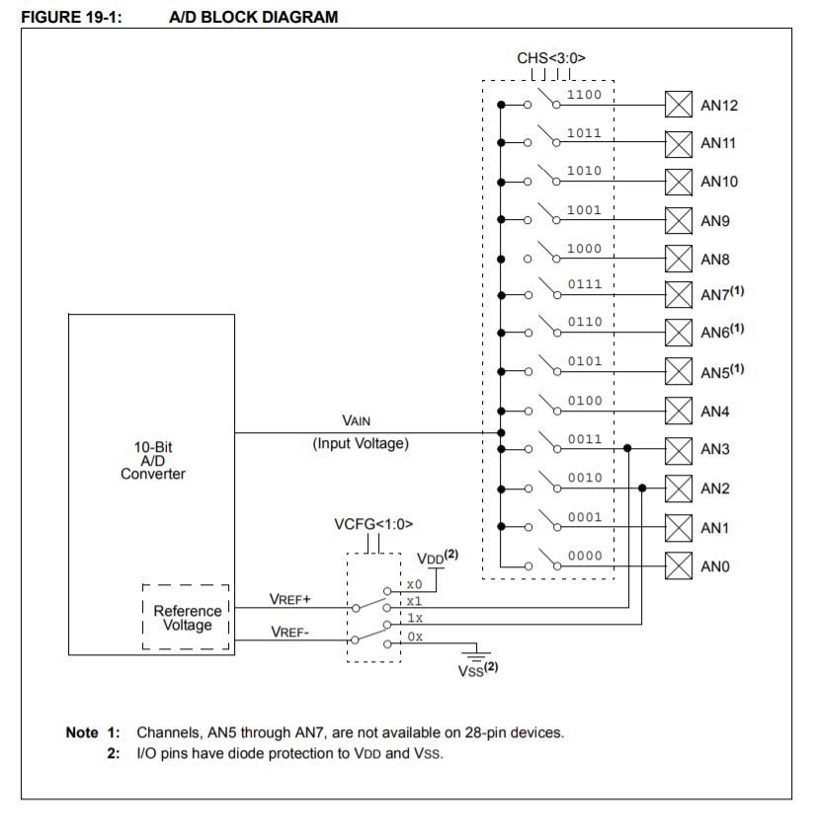
PIC18F4520: ADC Block Usage
ADC usage steps
ADCON1
PCFG values (A/D),
Reference voltages (V_{REF})
ADCON0
Input channel (ANx)
ADCON2
Justification (ADFM)
Acquisition Time (ACQT)
Clock (ADCS)
ADCON0
Put ADC ON (ADON)
ADCON0
Start conversion (GO/DONE)
Gather output
ADRESH:ADRESL
√
left
right
ADRESH
ADRESL
√
√

Slide 17
PIC18F: ADC Summary
ADC
Concept
Advantages, Limitations
PIC18F4520 ADC
Details
Usage
Output in
ADRESH:ADRESL (10 out of 16 bits)
Needs to be used appropriately
Inbuilt ADC (low-end real-world circuits)
Saves cost
Reduces power
Minimizes PCBA real-estate

Slide 18
Thank you!

